Slide 1
Google Cloud Platform
GCP – Cloud Firestore
LEVEL – PRACTITIONER

Slide 2

Cloud Firestore
Cloud Firestore is a NoSQL, document-oriented database. Unlike a SQL database, there are no tables or rows. Instead, you store data in documents, which are organized into collections.
Each document contains a set of key-value pairs.

Slide 3
Cloud Firestore key capabilities
Flexibility - The Cloud Firestore data model supports flexible, hierarchical data structures. Store your data in documents, organized into collections.
Expressive querying - In Cloud Firestore, you can use queries to retrieve individual, specific documents or to retrieve all the documents in a collection that match your query parameters. Your queries can include multiple, chained filters and combine filtering and sorting. They're also indexed by default, so query performance is proportional to the size of your result set, not your data set.
Realtime updates - Like Realtime Database, Cloud Firestore uses data synchronization to update data on any connected device. However, it's also designed to make simple, one-time fetch queries efficiently.

Slide 4
Cloud Firestore key capabilities
Offline support - Cloud Firestore caches data that your app is actively using, so the app can write, read, listen to, and query data even if the device is offline. When the device comes back online, Cloud Firestore synchronizes any local changes back to Cloud Firestore.
Designed to scale - Cloud Firestore brings you the best of Google Cloud's powerful infrastructure: automatic multi-region data replication, strong consistency guarantees, atomic batch operations, and real transaction support.

Slide 5
Initialize Cloud Firestore
Initialize on your own server - Below are the command we have to use to initialize firestore on your own server. We have to use service account which should have the required access on firestore.
import firebase_admin
from firebase_admin import credentials
from firebase_admin import firestore
# Use a service account.
cred = credentials.Certificate('path/to/serviceAccount.json')
app = firebase_admin.initialize_app(cred)
db = firestore.client()

Slide 6
Initialize Cloud Firestore
Initialize on Google Cloud - Below are the command we have to use to initialize firestore on Google Cloud. No need to use any service account. It will use the credential assign to the resource.
import firebase_admin
from firebase_admin import firestore
# Application Default credentials are automatically created.
app = firebase_admin.initialize_app()
db = firestore.client()

Slide 7
Cloud Firestore - Read data
Read data - Use the data viewer in the Firebase console to quickly verify that you've added data to Cloud Firestore.
You can also use the "get" method to retrieve the entire collection.
users_ref = db.collection("users")
docs = users_ref.stream()
for doc in docs:
print(f"{doc.id} => {doc.to_dict()}")

Slide 8
Cloud Firestore - Add data
Add data - Cloud Firestore stores data in Documents, which are stored in Collections. Cloud Firestore creates collections and documents implicitly the first time you add data to the document. You do not need to explicitly create collections or documents.
Create a new collection and a document using the following example code.
doc_ref = db.collection("users").document("emp001")
doc_ref.set({"first": "Rohan", "last": "Sharma", "born": "26/01/1990"})

Slide 9
Cloud Firestore - Update data
Update data – We can update the existing data. We have to add all the fields both changed and unchanged fields to update any existing document.
Update existing document using the following example code.
doc_ref = db.collection("users").document("emp001")
doc_ref.update({"first": "Rohan", "last": "Sharma", "born": "26/01/1992"})
Nate - The different between set and update is set overwrite all the fields with new key-value pairs whereas update can change the values only for the requested fields or add new for the new fields. Update only works on existing documents.

Slide 10
Cloud Firestore - Delete data
Delete data – We can delete records (document) from the collection.
Delete existing document using the following example code.
db.collection("users").document("emp001").delete()

Slide 11
Cloud Firestore – Secure your data
Secure your data – Use Cloud Firestore Security Rules or Identity and Access Management (IAM) to secure your data for mobile/web and server development, respectively.
// Allow read/write access on all documents to any user signed in to the application
service cloud.firestore {
match /databases/{database}/documents {
match /{document=**} {
allow read, write: if request.auth != null;
} } }
// Deny read/write access to all users under any conditions
service cloud.firestore {
match /databases/{database}/documents {
match /{document=**} {
allow read, write: if false; } } }

Slide 12
Cloud Firestore – Roles & privileges
Firebase IAM supports the following types of roles:
A) Basic roles:
Cloud Datastore Viewer
Cloud Datastore User
Cloud Datastore Owner
B) Predefined roles:
Firebase Admin
Firebase Viewer
C) Custom roles:
use various permissions and custom your own role for firebase.

Slide 13
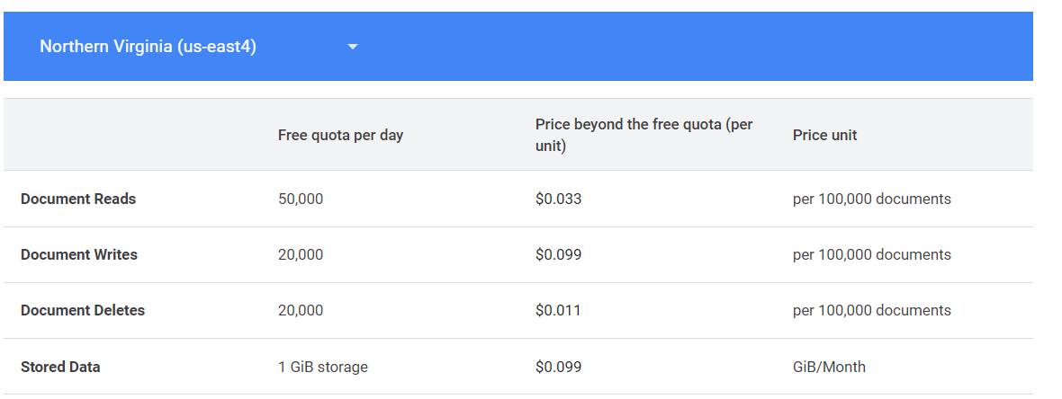
Cloud Firestore – Pricing
Get started at no cost, then pay as you go.
The following table lists pricing for reads, writes, deletes, and storage for us-east4 Firestore location:

Slide 14
Cloud Firestore – Reference
Please refer below URL for more details.
https://firebase.google.com/docs/firestore#:~:text=Cloud%20Firestore%20caches%20data%20that,changes%20back%20to%20Cloud%20Firestore.
https://firebase.google.com/docs/firestore/quickstart
https://cloud.google.com/firestore/docs/security/iam

